Slide 1
Brief Overview of Benefits of Our Bars
Our bars stand alone in the market because they are built on truly functional ingredients rather than just catchy protein numbers.

Slide 2
Randomized controlled trial of 51 adults aged 45-90 with mild cognitive impairment or early Alzheimer’s disease. Participants were randomized to 20 weeks of intensive lifestyle change vs usual care.
Intervention included: • Whole-food, minimally processed plant-based diet • Exercise (aerobic + strength) • Stress-management (meditation, yoga) • Social support

Slide 3
Cognitive & Functional Outcomes
Compared with controls, the lifestyle group showed: • Significant improvement on CGIC (p=0.001) • Significant benefit on CDR-Sum of Boxes (p=0.032) and CDR-Global (p=0.037) • Trend toward improvement in ADAS-Cog (p=0.053)
Controls declined, while intervention participants improved or stabilized.

Slide 4
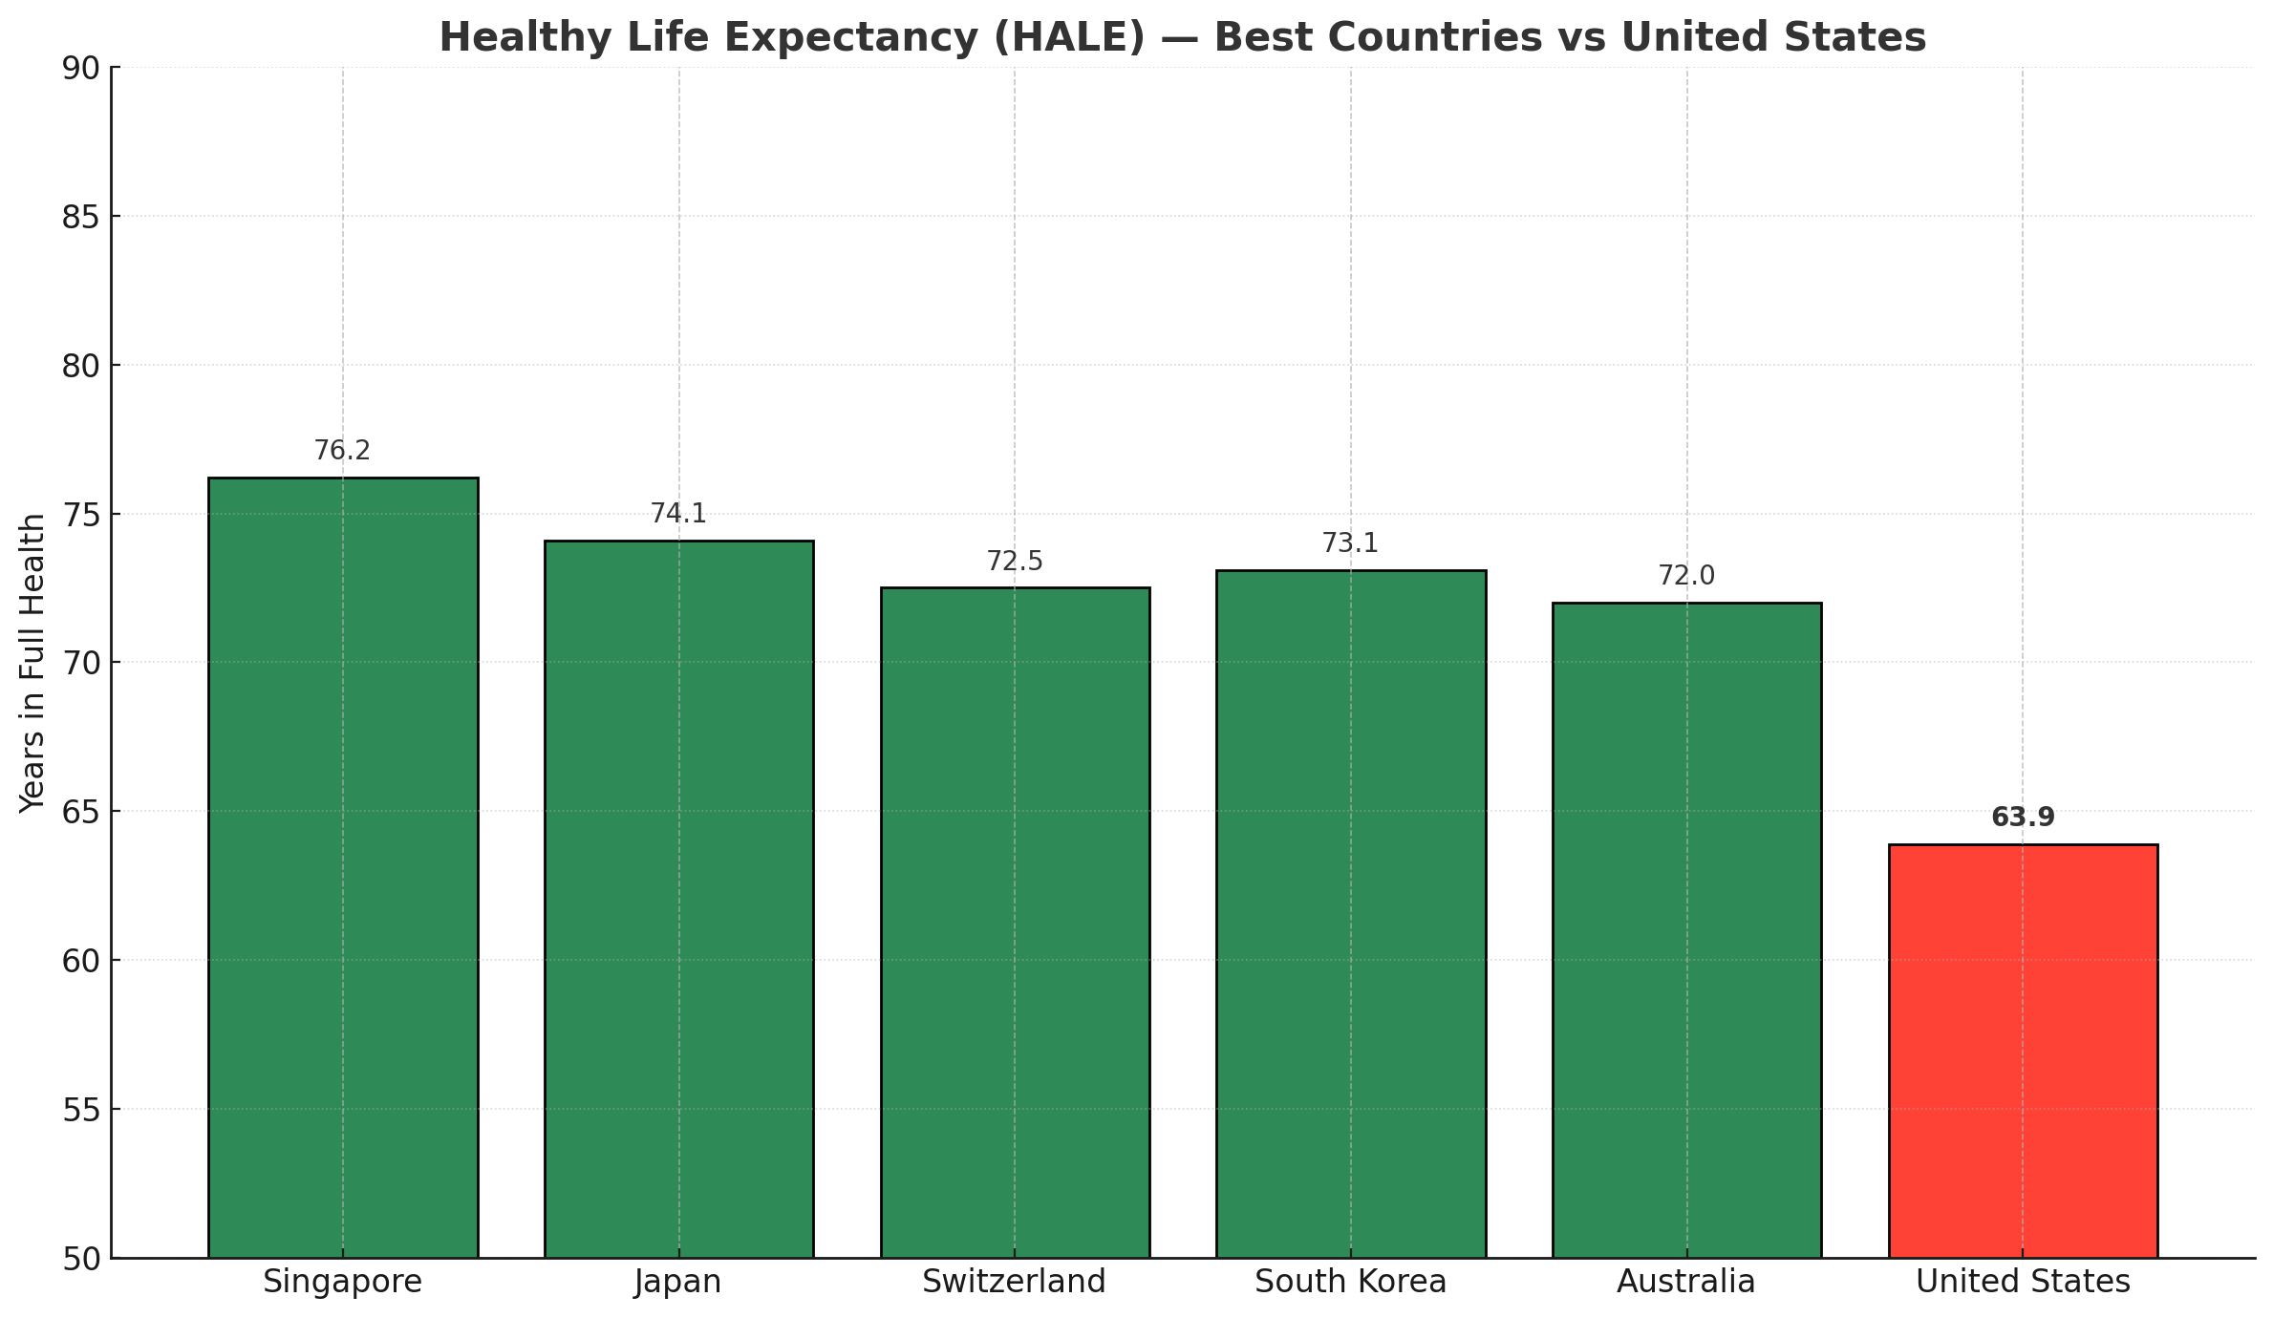

Slide 5


Slide 6
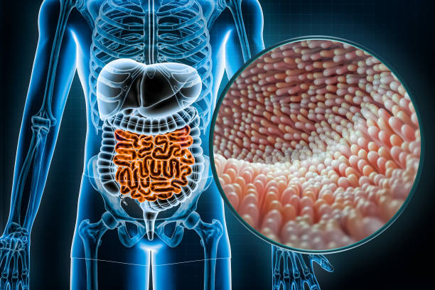
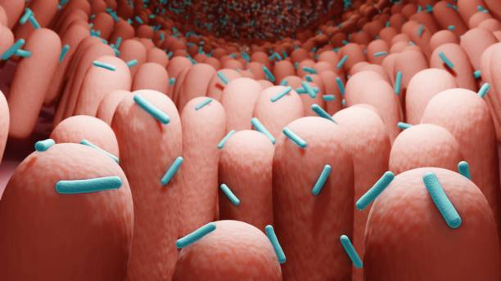
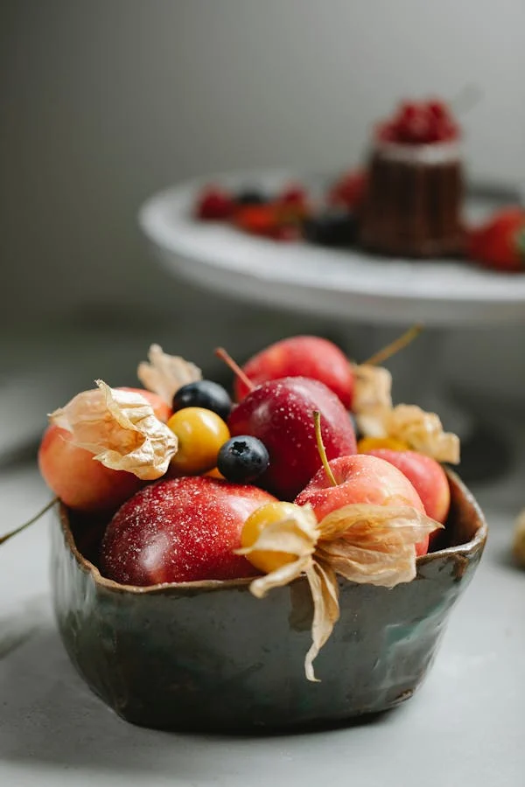
Prebiotics and Probiotics
10 trillion human cells in your body and around 100 trillion microbial cells
familiar with the "opposite" of probiotics: antibiotics
An average human digestive tract has approximately 400 types of probiotic fed bacteria
Lactobacillus acidophilus, which is found in yogurt, is the largest group of probiotic bacteria in the intestine

Slide 7

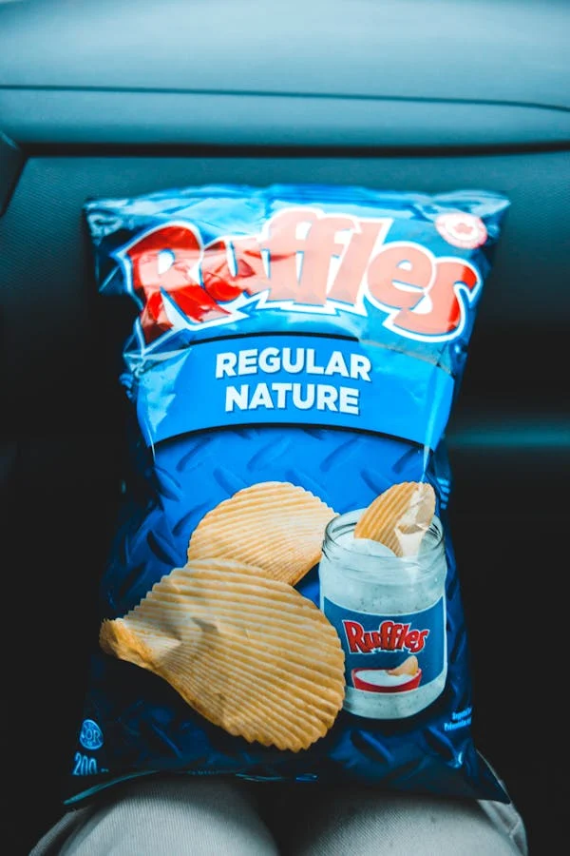
Low-fiber diet may cause irreversible depletion of gut bacteria over generations
The proliferation of nearly fiber–free, processed convenience foods since the mid–20th century has resulted in average per capita fiber consumption in industrialized societies of about 5-15 grams per day.
That’s as little as one–tenth of the intake among the world’s dwindling hunter–gatherer and rural agrarian populations
Research has linked an unbalanced gut microbiome to an increased risk for several cardiovascular diseases, including coronary heart disease, heart failure, stroke, heart attack, hypertension, and atherosclerosis. TMAO is bad because it is associated with cholesterol and artery narrowing plaque in important arteries
Trimethylamine N-oxide, commonly known as TMAO, is an organic compound that is produced by gut bacteria during digestion.

Slide 8
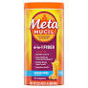
Fiber Supplement May Improve Brain Function why the gut-brain relationship is so important.
36 twin pairs (72 individuals), aged ≥60, each twin pair were randomised to receive either placebo or 7.5-gram fiber supplement daily for 12 weeks
The prebiotic supplement is well tolerated and results in a changed gut microbiome [e.g., increased relative Bifidobacterium abundance].
Prebiotics improved cognition compared with placebo

Slide 9
If you do not see Sugar on the Label it is Safe?
The words “syrup”, “sweetener”, and anything ending in “ose” can usually be assumed to be “sugar”. If the label says “no added sugars”, it should not contain any of the following, although the food could contain naturally-occurring sugars (such as lactose in milk).
Agave Nectar, Turbinado Sugar Xylose,Barley Malt Syrup
Beet Sugar, Brown Rice Syrup, Brown Sugar
Cane Sugar, Coconut Sugar, or Coconut Palm Sugar
Corn sweetener, Corn syrup, or corn syrup solids
Dehydrated Cane Juice, Dextrin, Dextrose
Evaporated Cane Juice, Fructose ,Fruit juice concentrate
Glucose, High-fructose corn syrup, Honey,Invert sugar, Lactose
Maltodextrin, Malt syrup, Maltose, Maple syrup, Molasses,Palm Sugar
Raw sugar Rice Syrup, Saccharose, Sorghum or sorghum syrup
Turbinado, Sugar Xylose

Slide 10
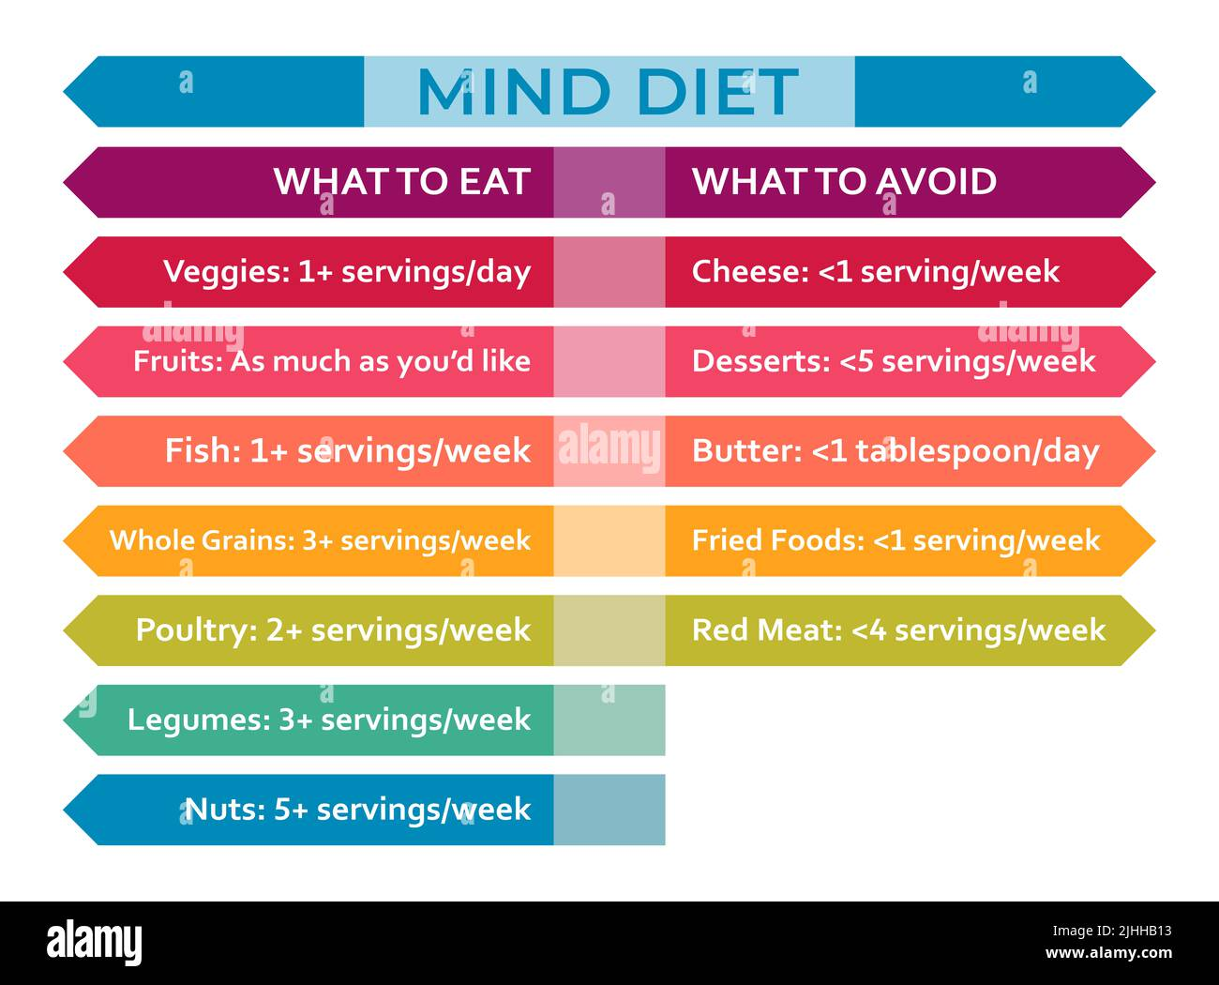
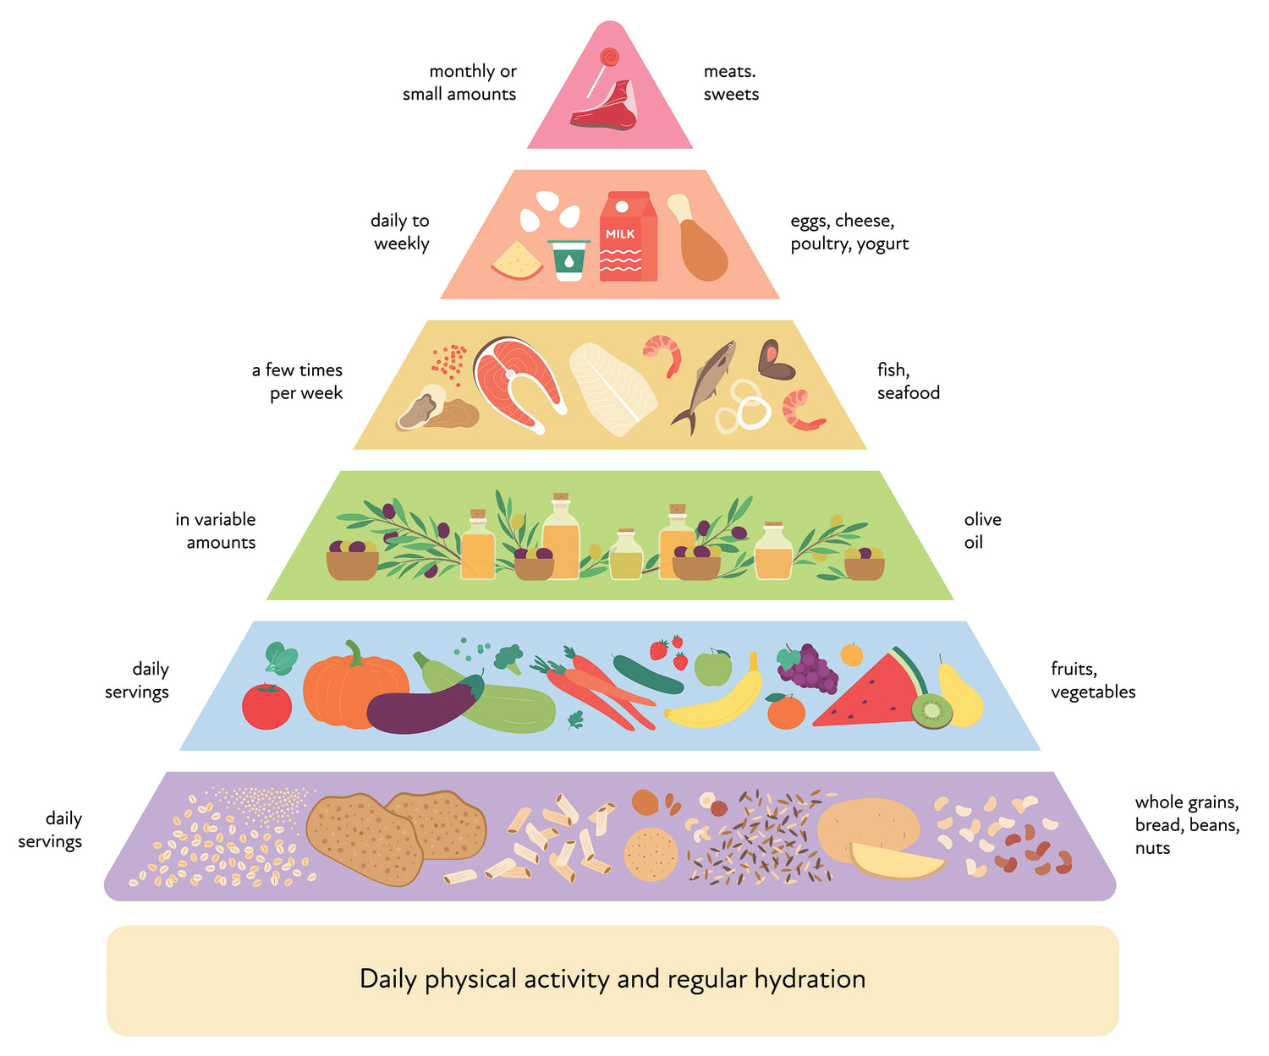
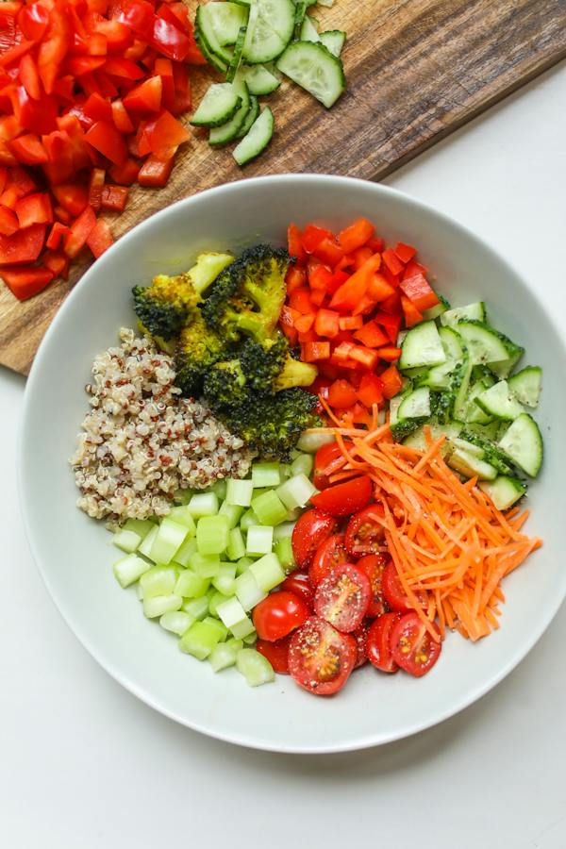
Even With Alzheimer's Pathology, Healthy Lifestyles May Preserve Cognition More data support the idea of "cognitive reserve"
The MIND diet features vegetables, especially green leafy vegetables such as spinach, romaine lettuce and kale; berries over other fruit. Beans, Nuts, And One Or More Weekly Servings Of Fish.
The Mediterranean Diet Consists Of Vegetables, Fruit, Legumes, Nuts, And At Least Three Servings Of Fish Each Week.

Slide 11
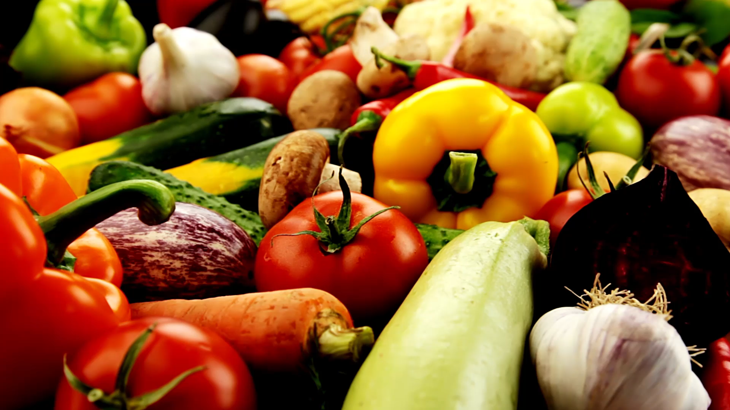
Ultra-processed foods linked to 32 health problems

Slide 12

Ultra-processed foods linked to 32 health problems
Higher ultra-processed food intake was associated with:
about a 50 percent increased risk of cardiovascular disease-related death
21 percent greater risk of death from any cause
a 48 to 53 percent higher risk of anxiety and common mental disorders
22 percent increased risk of depression
a 12 percent greater risk of Type 2 diabetes.

Slide 13
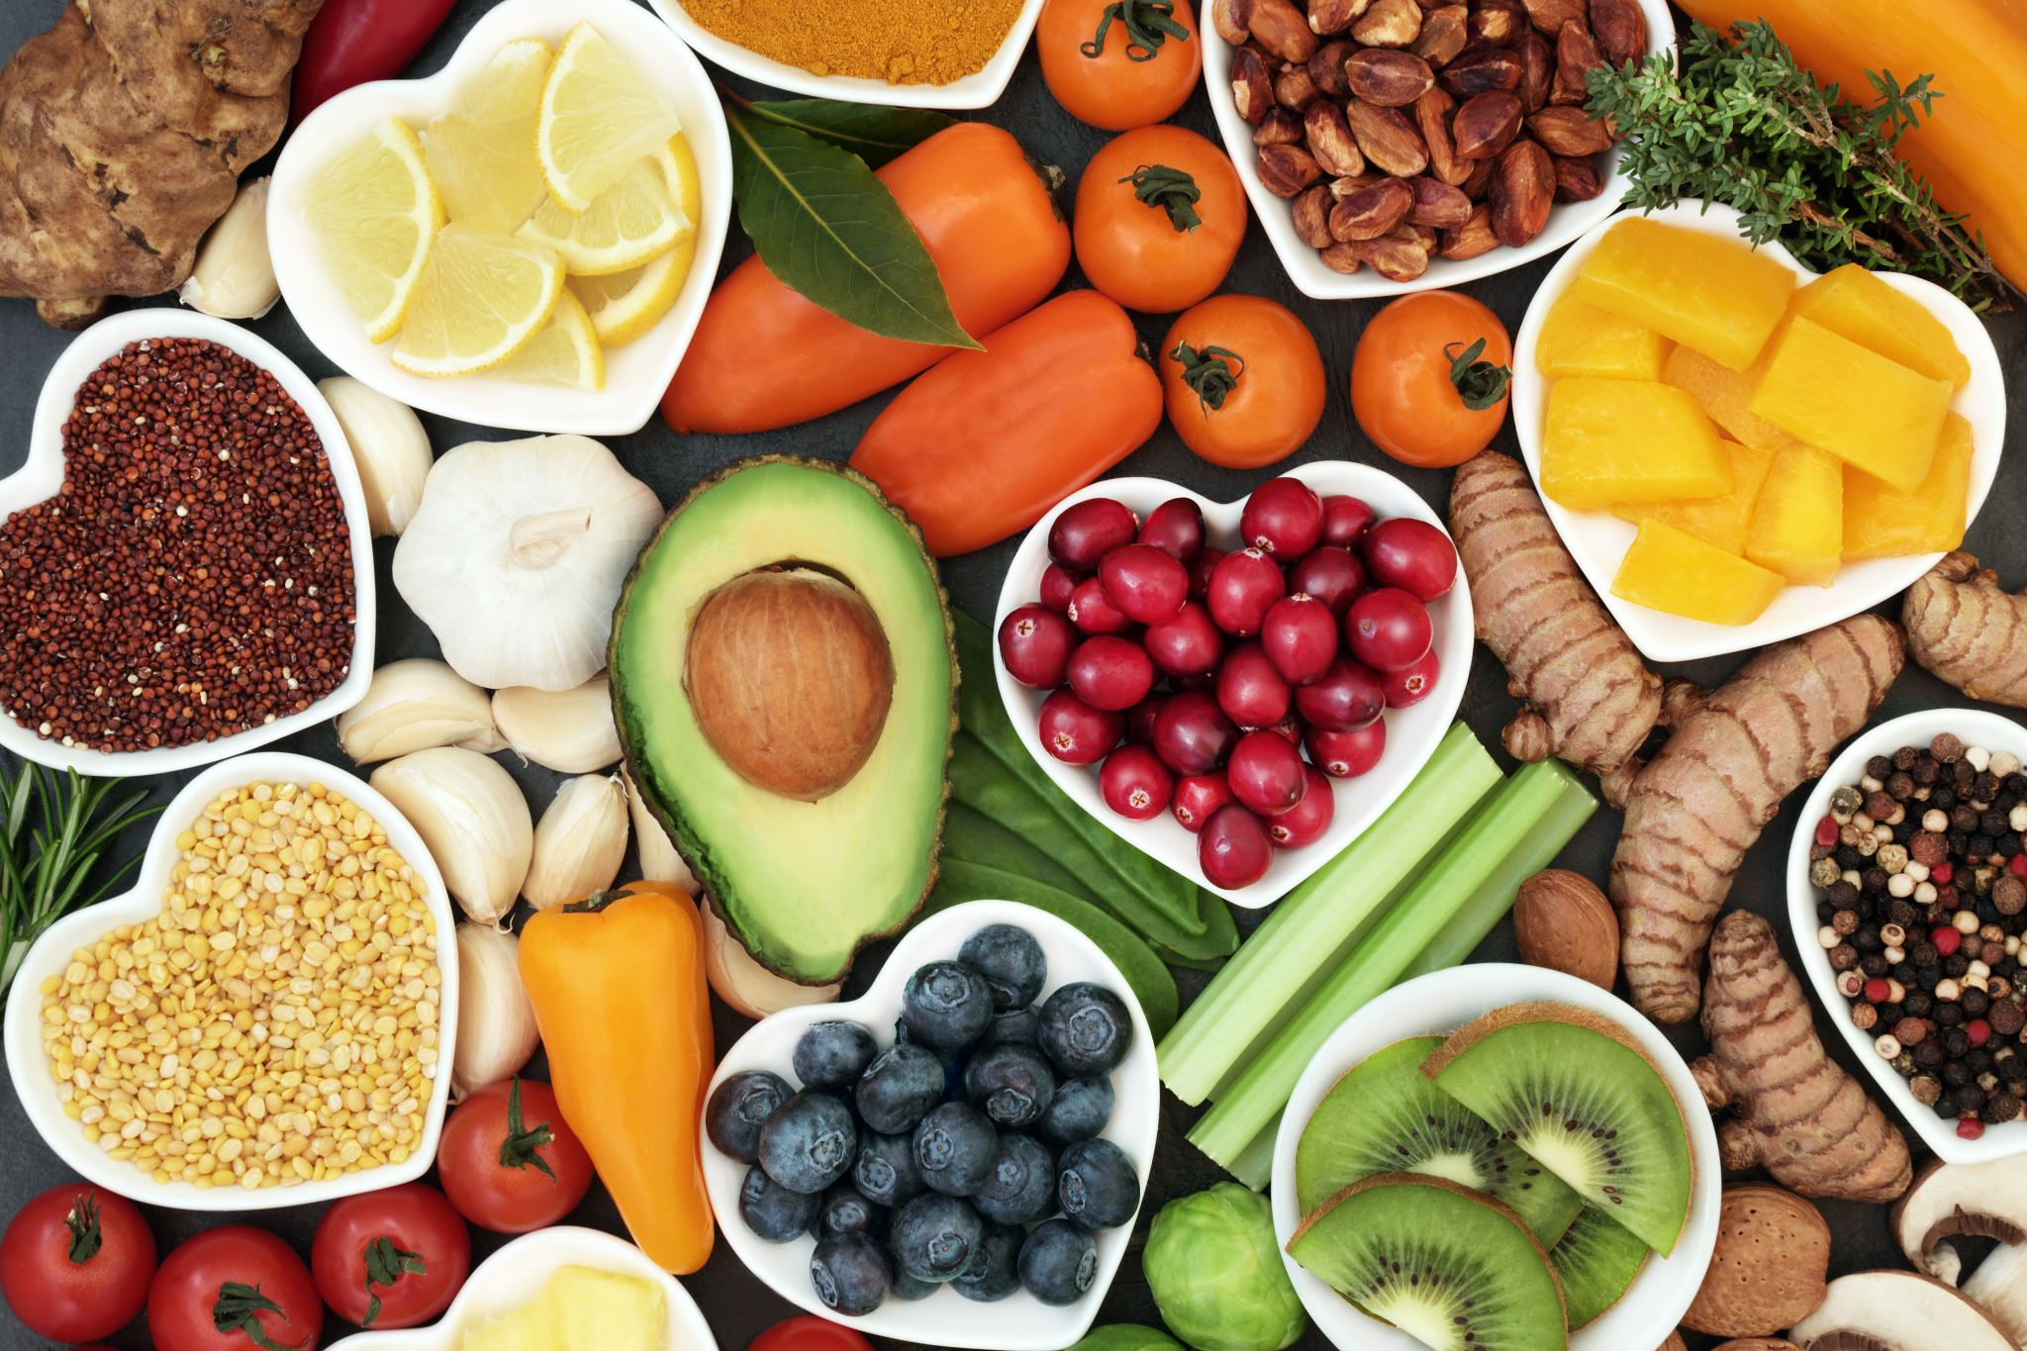
Flavonol-rich foods may help lower disease risk, boost longevity

Slide 14

Key Findings
Highest flavonol intake correlated with:
55% reduced risk of cancer-related mortality.
33% reduced risk of cardiovascular disease mortality.
36% reduced risk of death from other causes.
Notable: Myricetin associated with 66% lower risk of Alzheimer’s disease-specific mortality.
Oranges
Blueberry leaves1
Grapes
Broccoli
Cabbage
Peppers (red chili, green chili, bell peppers)1
Tomatoes
Nuts
Berries
Tea

Slide 15
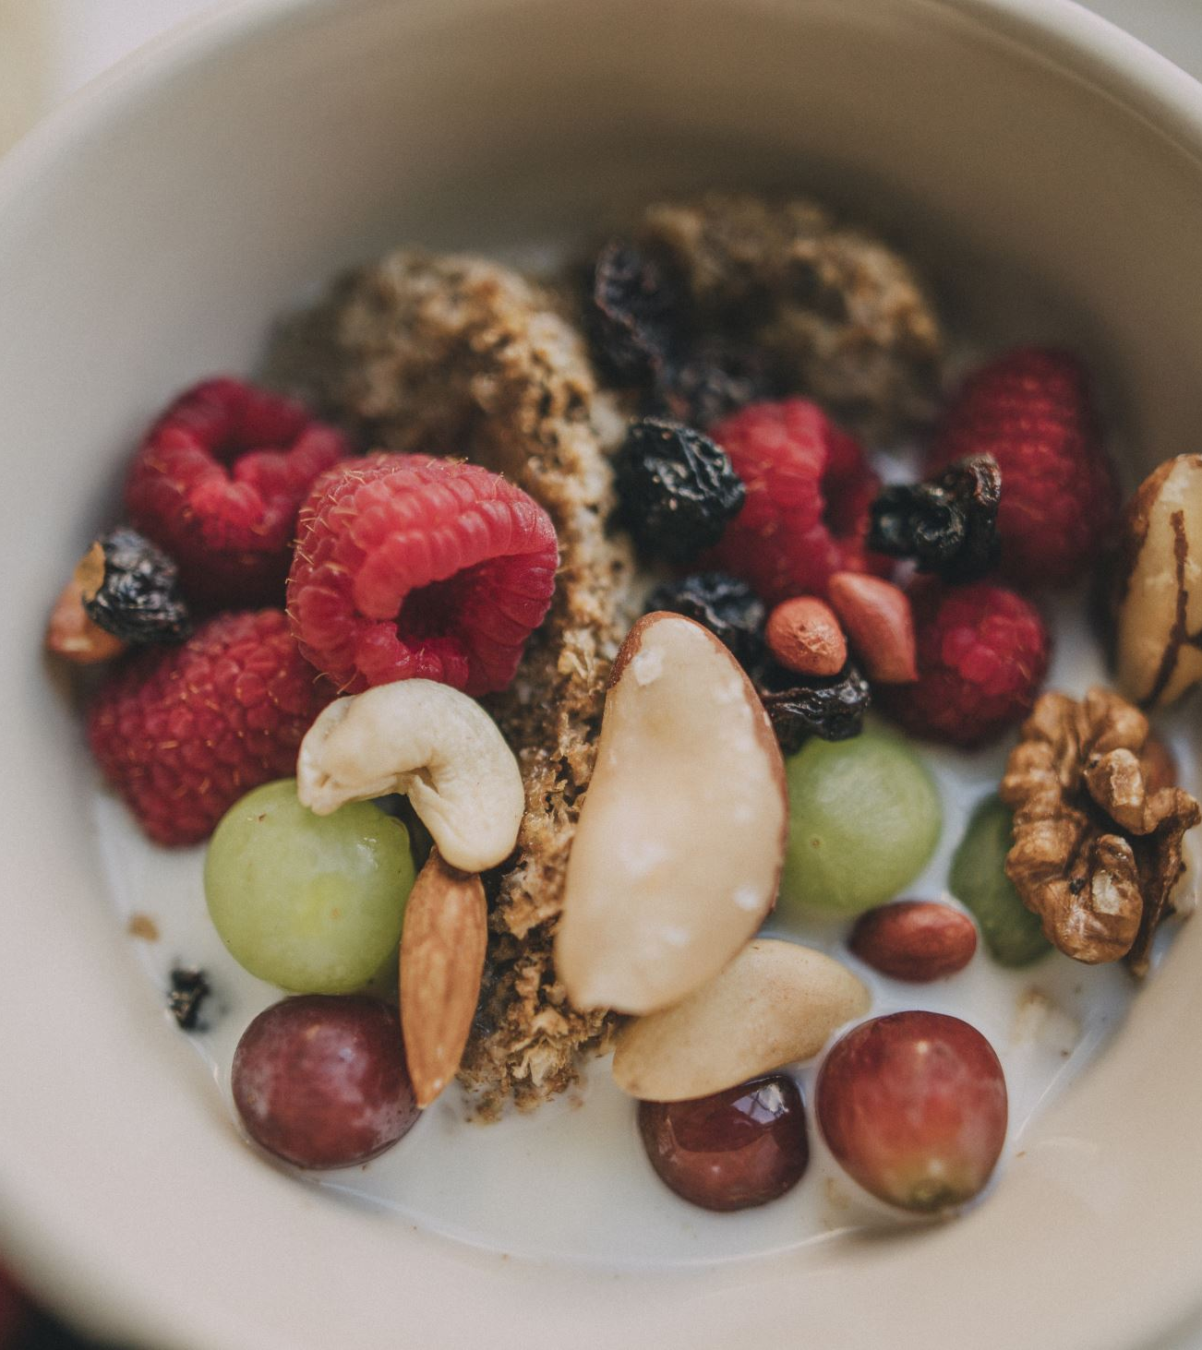
More Flavonols Into A Healthy Diet
Richest sources include:
• Tea: Green And Black Tea
• Chocolate: Dark Chocolate Or Cocoa
• Legumes: Chickpeas And Soybeans
• Fruit: Apples, Grapes, Cherries, Citrus Fruits
• Vegetables: Red Onion, Artichokes, Bell Peppers
• Berries: Blueberries, Black Berries, Raspberries, Black Currants, Cranberries, And Other Berries
• Herbs: Dill, Parsley, And Oregano
• Dark Leafy Greens: Spinach And Kale
• Grains/Pseudo-grains: Buckwheat And Quinoa

Slide 16
High-Fiber Advantage & Ingredient Purity
13g fiber per bar (46% DV) from tapioca fiber, seeds, greens, and fruits
Supports gut health, blood sugar control, satiety, cholesterol, and regularity
❌ No artificial sweeteners, food dyes, sugar alcohols, or non-caloric sweeteners
✅ 100% whole-food sweeteners like organic dates and berries
Very few bars on the market have this level of purity and fiber content

Slide 17
Artificial Sweeteners & Cognitive Decline
New study (Neurology, 2025): 7 sweeteners linked to 62% faster cognitive decline
Affected memory and thinking skills; especially in people <60 and with diabetes
Sucralose-6-acetate found to be genotoxic – damages DNA, harms gut health
Associated risks: cardiovascular disease, cancer, migraines, metabolic syndrome
Our bars avoid all such sweeteners — protecting brain, gut, and metabolic health

Slide 18
The Ultra-Processed Food Epidemic
CDC (2025): Americans get 55% of calories from ultra-processed foods
Children consume 61.9% of calories from ultra-processed foods
Linked to chronic disease: obesity, T2DM, cardiovascular issues, early death
Our bars are real food — no preservatives, dyes, emulsifiers, or chemical sweeteners
We align with White House push to reduce ultra-processed foods in schools and homes

Slide 19
Mediterranean & MIND Diet Alignment
HealthSpan Bars follow principles of the Mediterranean and MIND diets
Rich in fiber, plant-based proteins, polyphenols, and healthy fats
Include nuts, seeds, berries, leafy greens, and olive oil-equivalent fats
MIND diet shown to reduce Alzheimer’s risk and slow cognitive decline
Unlike most bars, we are NOT an ultra-processed food
We use real, whole-food ingredients — no emulsifiers, dyes, or sweeteners

Slide 20
MD Health Bars
Science-Driven Nutrition for Brain, Body, and Microbiome
Supporting Healthy Lifestyles — Every Bar Fuels a Mission

Slide 21
Ingredient Snapshot: MD Health Bars
• Organic Dates
• Peanut Butter & Peanut Flour
• Pumpkin Seeds & Chia Seeds
• Unsweetened Cacao Chips & Cocoa Powder
• Tart Cherries & Blueberries
• Kale, Spinach, Broccoli (Greens Blend)
• Beet & Turmeric
• Tapioca Fiber & Vanilla Extract
• Water (minimal processing)

Slide 22
Our Social Mission
We donate a portion of all proceeds to childhood nutrition charities
Focused on reducing sugar and ultra-processed food intake in kids
Helping schools and families shift toward whole-food, high-fiber nutrition
MD Health Bars = A bar with a purpose: Fueling kids’ minds and bodies

Slide 23
Nuts (Peanuts)
Rich in monounsaturated fats → improve LDL:HDL ratio and cardiovascular health
Provide plant-based protein for satiety and muscle maintenance
Contain resveratrol and polyphenols → potential neuroprotective effects
May reduce risk of type 2 diabetes and all-cause mortality (NEJM 2013)
[NEJM, 2013] Frequent nut consumption linked to a 20% lower death rate
Peanuts linked to lower cardiovascular risk (JAMA Intern Med. 2015)

Slide 24
Seeds (Pumpkin & Chia)
Chia seeds: Omega-3 ALA, fiber (10g/oz), complete protein, antioxidant activity
Pumpkin seeds: Magnesium, zinc, tryptophan, and phytosterols
Improve gut health, lipid profiles, and possibly cognition
Chia lowers postprandial glucose (Diabetes Care 2007)
Pumpkin seed oil may reduce blood pressure (Phytother Res 2011)

Slide 25
Berries (Tart Cherries & Blueberries)
Tart cherries: Anthocyanins reduce inflammation, improve sleep
Blueberries: Improve memory and executive function
High antioxidant (ORAC) scores
Blueberries slow cognitive decline (Ann Neurol. 2012)
Tart cherry juice reduces DOMS (Scand J Med Sci Sports, 2010)

Slide 26
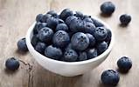
Blueberries could help fight Alzheimer's, UC research shows University of Cincinnati Academic Health Center
adults aged 68 and older performed better on cognitive tests after 16 weeks of taking blueberry powder supplements, versus a control group taking a placebo
real benefit in improving memory and cognitive function in some older adults
beneficial effects could be due to flavonoids called anthocyanins, which have been shown to improve animals’ cognition

Slide 27
Could berries be better than statins??
Sixty percent of the anthocyanins consumed by the women came from blueberries.
93,600 women who were 25 to 42 years old when they entered the Nurses’ Health Study. After 18 years, the risk of heart attack in those who got the most anthocyanins from their food (at least 25 milligrams a day) was 32 percent lower than the risk in those who got the least (2.5 mg a day or less).
blueberries (which average about 530 mg per cup) and strawberries (35 mg per cup), blackberries (355 mg per cup), cherries (175 mg per cup), raspberries (115 mg per cup), red cabbage (115 mg per cup), red grapes (45 mg per cup), and black plums (35 mg each),
Remember we are only talking about at least 25 mg a day.

Slide 28
100% Dark Chocolate (Cacao Chips & Cocoa Powder)
High in flavanols: improve endothelial function and reduce BP
Enhance cerebral blood flow and possibly memory
Anti-inflammatory and antioxidant properties
Cocoa flavanols improve cognition (J Nutr. 2008)
Habitual intake linked to reduced CV events (BMJ 2012)

Slide 29
Leafy Greens (Kale, Spinach, Broccoli)
Rich in vitamin K, folate, nitrates → support cognitive & vascular health
Contain lutein/zeaxanthin for brain and eye protection
Support detoxification and immune modulation
Slow cognitive decline (Neurology 2017)
Cruciferous vegetables lower cancer risk (JNCI 1996)

Slide 30
Beets
Rich in dietary nitrates → improve vascular and cognitive function
Support brain perfusion in aging populations
Contain anti-inflammatory betalains and fiber
Improve reaction time (Nitric Oxide 2017)
Enhance athletic performance (J Appl Physiol. 2009)

Slide 31
Omega-3s from Seeds
Chia and pumpkin seeds provide ALA → precursor to EPA/DHA
Support anti-inflammatory, cardioprotective, and neuroprotective function
ALA reduces fatal CHD (Circulation 2009)
Important omega-3 source in vegetarian diets

Slide 32
Dates
Natural sweetener with low glycemic impact when combined with fiber/protein
High in polyphenols, potassium, and prebiotic fiber
Aid digestion, antioxidant defense, and natural energy
In vitro antioxidant properties (J Agric Food Chem. 2013)
Improve labor and cervical ripening (J Obstet Gynaecol. 2011)

Slide 33
Tapioca Fiber
Resistant dextrin with prebiotic effects
Improves gut microbiota diversity and SCFA production
Reduces glucose/insulin spikes and promotes satiety
Increases bifidobacteria (Nutrients 2020)
Improves glycemic response (J Food Sci 2018)

Slide 34
Vanilla Extract
Contains vanillin: mood-enhancing and anti-inflammatory effects
Adds satiety and sensory satisfaction
Antioxidant, anti-cancer potential (Food Chem Toxicol 2007)
Reduces oxidative stress (Plant Foods Hum Nutr 2005)

Slide 35
Turmeric (Curcumin)
Potent anti-inflammatory and antioxidant (curcumin)
Modulates inflammatory pathways (NF-κB, COX-2, TNF-α)
Supports gut, joint, and cognitive health
Improves IBS/IBD symptoms (J Altern Complement Med 2004)
Enhances cognition in long-term users (Am J Geriatr Psychiatry 2018)

Slide 36

Cinnamon may be fragrant medicine for the brain
There are a lot of potential benefits of cinnamon including helping with glucose control and may lower blood sugar in people with diabetes.
Poor–learning mice took about 150 seconds to find the right hole in the Barnes maze test. On the other hand, after one month of cinnamon treatment, poor–learning mice were finding the right hole within 60 seconds.

Slide 37
Mediterranean & MIND Diet Alignment
MD Health Bars follow principles of Mediterranean and MIND diets
Include nuts, seeds, berries, leafy greens, healthy fats, and polyphenols
Rich in fiber and whole-food ingredients with minimal processing
MIND diet shown to slow cognitive decline and lower Alzheimer’s risk
No ultra-processed ingredients, preservatives, or artificial additives

Slide 38
We Are Not Ultra-Processed
Ultra-processed foods make up 55–62% of calories in the average American diet (CDC 2025)
Linked to higher risk of obesity, type 2 diabetes, cardiovascular disease, and early mortality
Most bars on the market contain preservatives, emulsifiers, sweeteners, and dyes
MD Health Bars are made with real, whole-food ingredients you can recognize
No gums, isolates, additives, or artificial flavors — truly clean label

Slide 39
MD Health Bars: Fueling a Healthier Future
Every bar supports your health — and helps fund child nutrition programs.
Whole Food • Science-Backed • Delicious • Purpose-Driven

